Slide 1
PHYSICS 425 : Solid State Physics Spring 2013
(MW 4.00 – 5.15 pm)
Instructor: Thushari Jayasekera
Office: Neckers 478
Tel:(618)-453-1055
Email: thushari@siu.edu
Office Hours: Wednesday 2.00-4.00 pm
Text Book: Introduction to Solid State Physics 8th Ed., by Charles Kittel
(7th edition can be used but it does not have Chapter 18)
Other References: Solid State Physics Aschroft/Mermin
Elementary Solid State Physics M. A. Omar
Goal:
Study the properties of materials in an atomistic view
Why:
Macroscopic properties of materials are a result of microscopic structure

Slide 2
Course Content
ATOMIC STRUCTURE:
The idea of crystals
Introduction to crystals -2-D crystal structures and their symmetries
Three Dimensional Crystal Structures
Experimental Determination of Crystal Structures – Introduction to Reciprocal Lattice
Surfaces and Interfaces
Complex Structures (Alloys, Glasses, Polymers etc)
ELECTRONIC STRUCTURE:
The single electron model
The Schrodinger Equation and Symmetry – Bloch’s Theorem
Nearly Free Electrons and Tight Binding Model
Electron-Electron Interactions : Introduction to Advanced Methods for Electronic Structure Calculations
Calculation of Electron Band Structures - Metals, Semiconductors and Insulators
MECHANICAL PROPOERTIES:
Introduction to Lattice Vibrations and their Applications
SPECIAL TOPICS:
Quantum Confined Structures (Semiconductors, Graphene etc)

Slide 3
Grading: Homework & Quizzes --- 30%
Exam 1 --- 20 %
Exam 2 --- 20 %
Final Exam --- 30%
Total = 100%
Grade Policy:
A 85% -100%
B 75 % - 84 %
C 60 % - 74 %
D 50 % - 59.9 %
F Less Than 50%

Slide 4
Introduction
Materials are an essential part of all products and process.
Material science provides engineers and scientists with the knowledge required to
Select appropriate materials;
Design materials appropriate for specific applications;
Use materials appropriately, efficiently, and safely;
Dispose of these materials after their useful life.

Slide 5
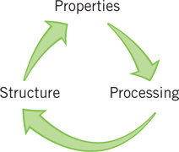
Why study structure of Materials?
Materials are selected for applications based on their properties
Properties are determined by structure
Structure can be altered by processing

Slide 6
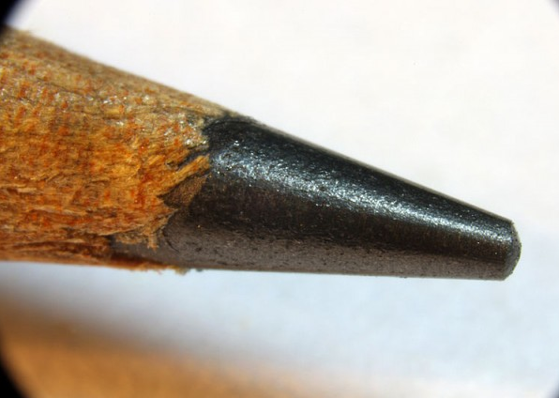
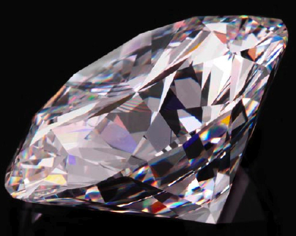
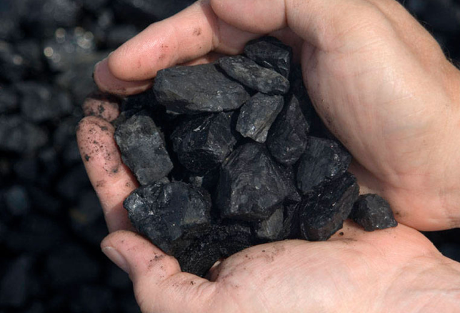
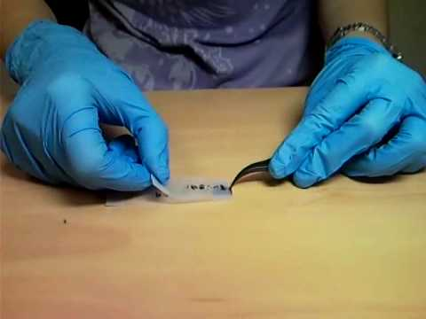
Properties of Materials
Graphite
Diamond
Coal
Graphene
Same Material: Here it is Carbon.
Different Atomic arrangements. Drastically different properties

Slide 7
Atomic Arrangement of Materials
Sometimes materials can be found in crystalline order.
Why materials stay in a crystalline order? That is a hard question to answer.
Why the lowest energy is crystalline? It may be due to the fact that each atoms would like to come to the same environment. So the environment is repeating to make a crystalline state.
Also the arrangement depends on the way the material is made.
Structures Change:
Equilibrium structure can be a function of temperature and pressure. Some materials change to several crystalline structures before it melts.
Some materials have few types of crystalline states at a given temperature and pressure (Allotropes)

Slide 8
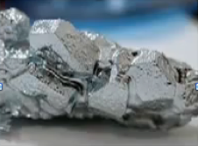
Sometimes materials can be found in crystalline order.
In Nature however, materials occur in
crystals with defects/ impurities.
If we learn the properties of a perfect crystals, it would be then possible to learn the properties of the same materials with defects/impurities treated as perturbations

Slide 9
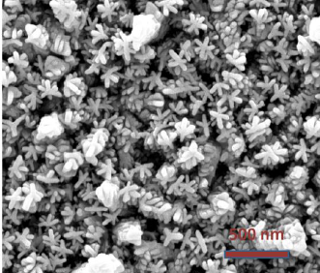
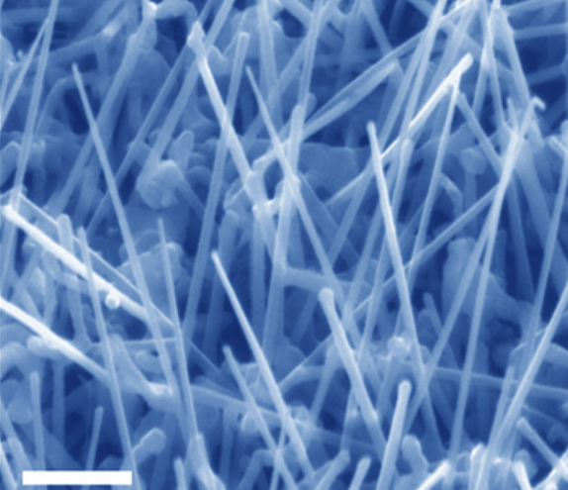
Atomic Arrangement of Materials
Some times, the materials come in different arrangements in the nature, Some times we make them in different arrangements,
Either way, we need to understand their properties, How do they conduct current, how much they get heated as you pass current, How strong they are? What is their reaction to light etc etc….
Mainly, how can we use these creatures to improve our lives

Slide 10
The goal of the class is thus set to:
Study the Macroscopic properties of materials from atomistic point of view.

Slide 11
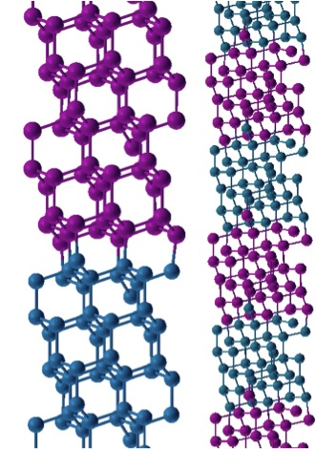
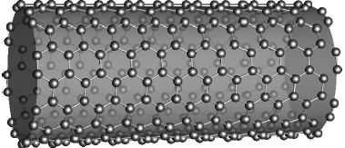
Study the Macroscopic properties of materials from atomistic point of view.

Slide 12
We need to understand the terminology:
CRYSTAL: A solid is a crystal if the atoms are arranged in such a way that their positions are exactly periodic. (Long Range Ordered Materials)
Bravais Lattices: A collection of points in which the neighborhood of each atom is identical to each other.
Let’s start with a two dimensional crystals to refresh what we know about the lattices.

Slide 13
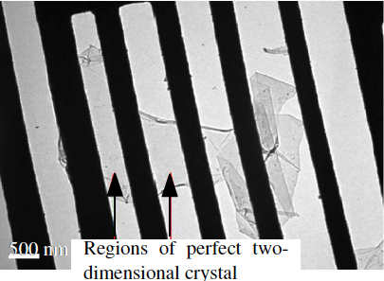
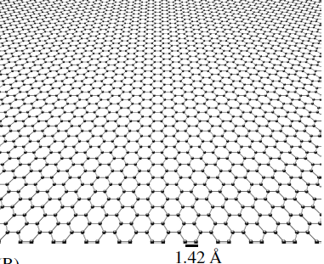
Two-Dimensional Lattices
There are five Bravais Lattices in 2D.

Slide 14
There are five Bravais Lattices in 2D.
Square Lattice
Rectangular Lattice
Hexagonal Lattice
Centered Lattice
Oblique Lattice

Slide 15
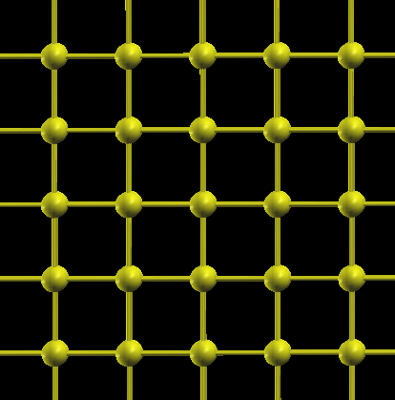
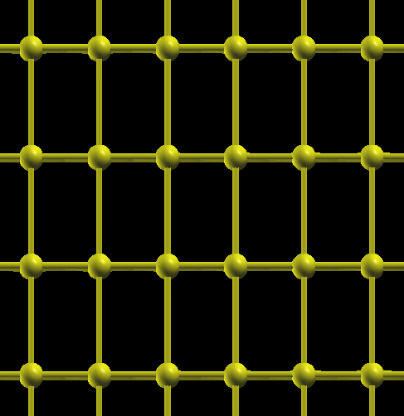
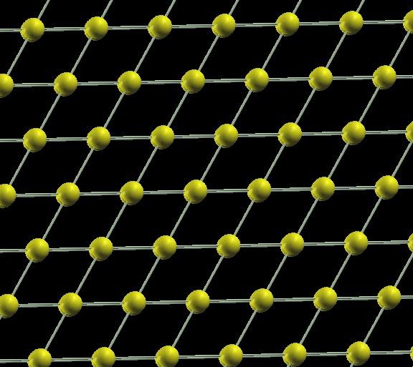
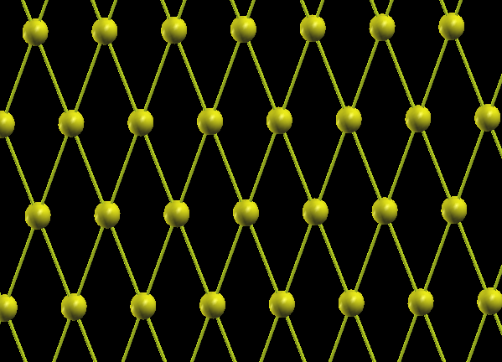
Rectangular Lattice
Square Lattice
Symmetric under reflection about both x and y
90 degree Rotational symmetry is lost
Symmetric under reflection about both x and y
90 degree Rotational symmetry
Hexagonal Lattice
Centered Rectangular Lattice

Slide 16
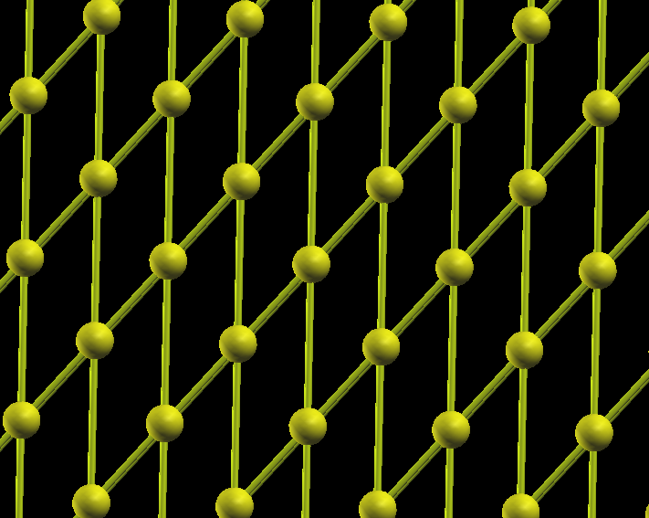
Oblique Lattice

Slide 17
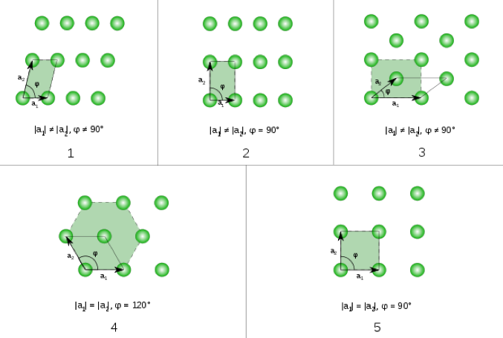

Slide 18
Square Lattice
The location of every point can be described as:
R=n1 a1 + n2 a2
a1 & a2 are primitive vectors

Slide 19
Primitive Vectors are not unique
a1 = (1 ,0 )
a2 = (1/2 ,√3/ 2)
a1 = (1/2 , √3/ 2 )
a2 = (-1/2 ,√3/ 2)
Both vectors are OK. The vectors need to be independent.

Slide 20
Lattice with Bases
Let’s remind that:
The neighborhood of all particles must be identical in order for a lattice to be qualified for a Bravais Lattice.
Most Lattices in nature are not however Bravais Lattices. Some times these are called non-Bravais lattices.
Those non-Bravais lattices can be described by a Bravais lattice with a basis.
Lattice with a Basis --- We begin with a Bravais lattice. Each lattice point is replaced by a collection of an identical assembly of particles.
Example : Honeycomb Lattice

Slide 21
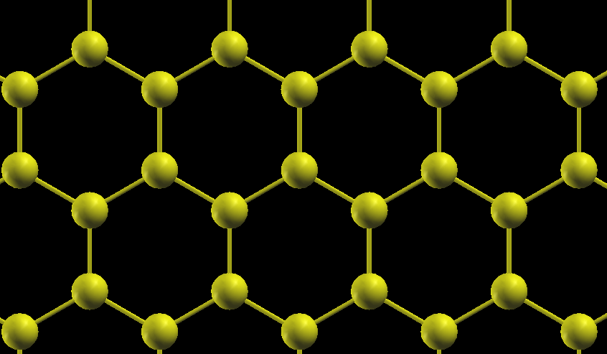
Hexagonal Lattice
Honeycomb Lattice

Slide 22
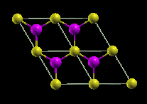
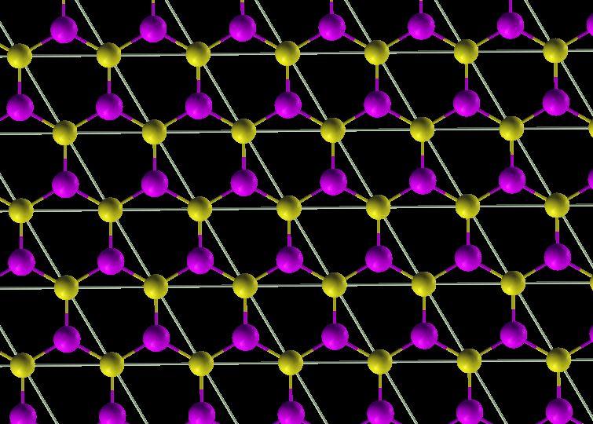
Honeycomb Lattice – Hexagonal Lattice with a Lattice 2-atomic Basis
Lattice with a Basis

Slide 23
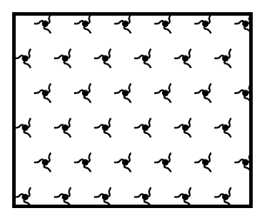
Another Lattice with a basis
A hexagonal lattice decorated with chiral molecules

Slide 24
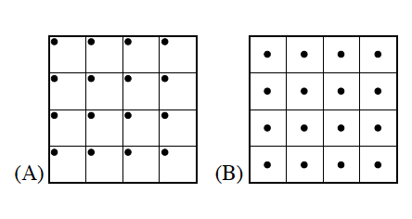
Primitive Cell:
The smallest unit which represents the whole lattice. It contains only one lattice point.
It is the minimum volume cell. But it is not unique. It is defined by primitive translation vectors.
Two primitive cells for the square lattice. One cell has a lattice point at the corer, while the other has a lattice point at the center.

Slide 25
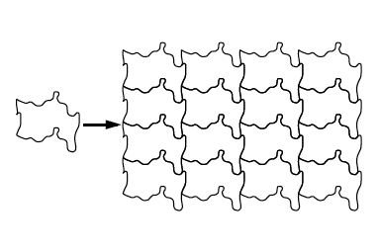
The shape can be any complicated way: as long as it contains only one lattice point.

Slide 26
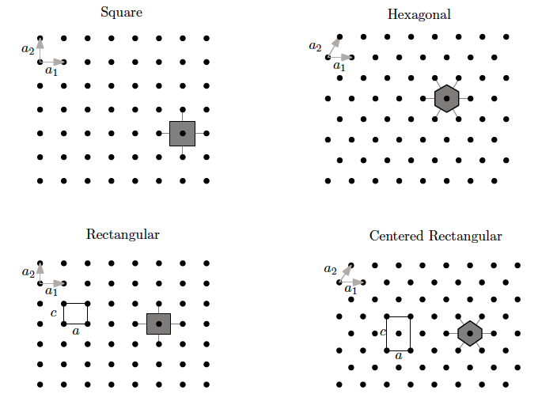
Wigner-Seitz Unit Cell
It is convenient to have a standard way of constructing the primitive cell
It is important to have a primitive cell which is invariant under all symmetry operations that leave the crystal invariant.
Such a construction is provided by the WIGNER – SEITZ unit cell.

Slide 27
Symmetries
Symmetries of crystals are important:
What we observe in the experiments are related to the symmetries in the crystals
In Theory: Solutions to the Schrodinger equation for electron in a periodic crystal is only possible when we can use the symmetries in the crystals
What is the symmetry?
Imagine you pick the lattice up, move it/ rotate it rigidly, place it back down. Will the lattice be overlap at their original positions.
Problem is to find a complete set of such motions that the crystal in to itself. That complete set is called a space group.
It is a group because it consists of a set of operations with a natural product (performs a first rigid body motion, then another, the resultant is still a rigid body motion. )
We will talk more about symmetries in Three-Dimensional Crystal Structures.

