Slide 1
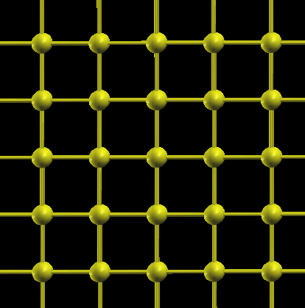
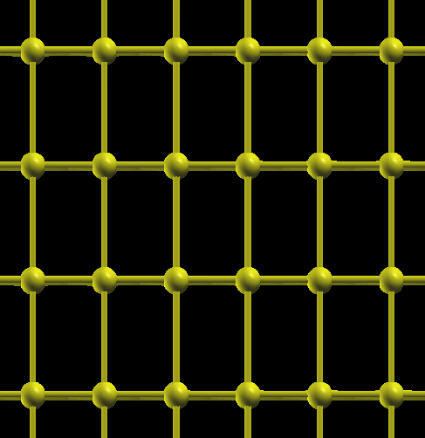
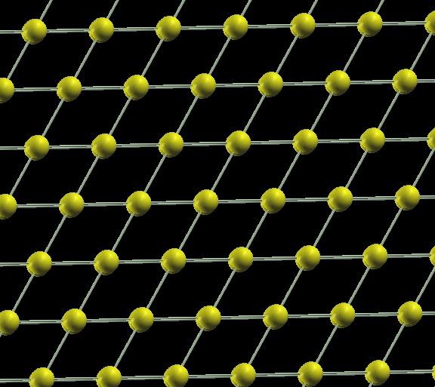
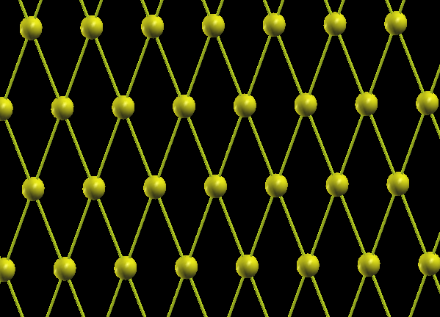
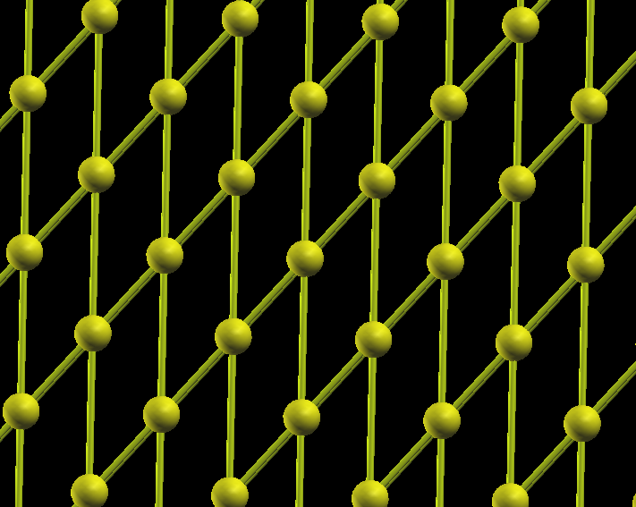
Refresh: 2D Lattices

Slide 2
Primitive Vectors are not unique
a1 = (1 ,0 )
a2 = (1/2 ,√3/ 2)
a1 = (1/2 , √3/ 2 )
a2 = (-1/2 ,√3/ 2)
Both vectors are OK. The vectors need to be independent.

Slide 3
Let’s identify simple long-range patterns.

Slide 4
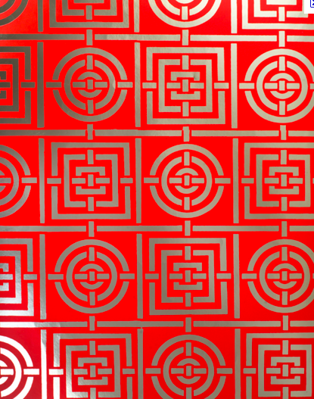

Slide 6
90 Degree Rotational Symmetry ?????

Slide 7
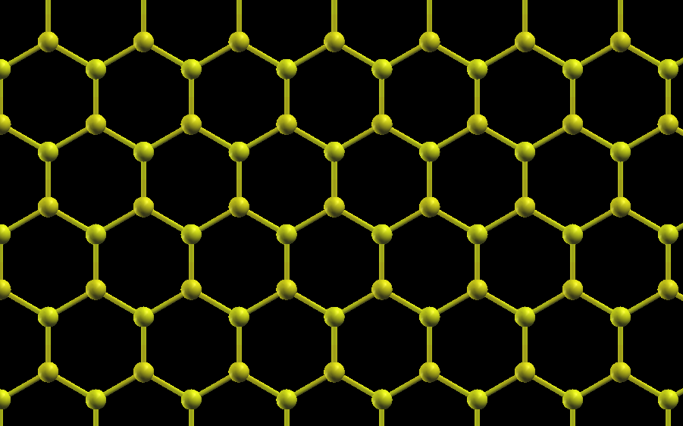
Honey-Comb Lattice
Let me try to identify points with the same environment

Slide 10
We can think of it as this:
It forms a hexagonal Bravais Lattice (or Hexagonal Primitive Lattice)

Slide 11
Lattice with a Basis:
It forms the honey comb lattice

Slide 12
This is the Unit cell with two-atomic basis
Again this is not unique, We could select this unit cell with the basis in different ways.

Slide 15
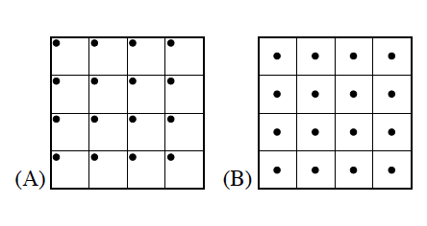
Primitive Cell:
The smallest unit which represents the whole lattice. It contains only one lattice point.
It is the minimum volume cell. But it is not unique. It is defined by primitive translation vectors.
Two primitive cells for the square lattice. One cell has a lattice point at the corer, while the other has a lattice point at the center.

Slide 16
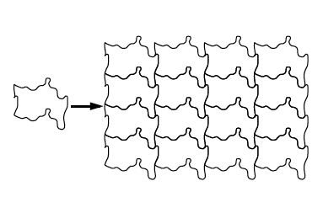
The shape can be any complicated way: as long as it contains only one lattice point.

Slide 17
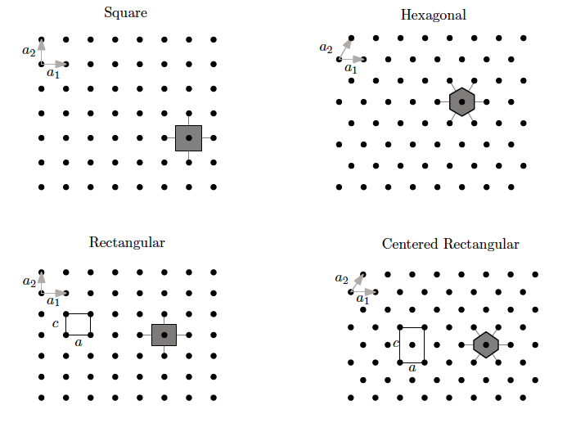
Wigner-Seitz Unit Cell
It is convenient to have a standard way of constructing the primitive cell
It is important to have a primitive cell which is invariant under all symmetry operations that leave the crystal invariant.
Such a construction is provided by the WIGNER – SEITZ unit cell.

Slide 18
Three-Dimensional Lattices
Classification of Lattices by Symmetry:
Similar to the case in 2D, what we are doing here is trying to find out ways to pack the 3D space. (more like tiling the 2D space)
In 3D, the lattice point in the space can be described by the primitive vectors:
R=n1a + n2 b + n3 c
a, b & c are basis vectors
Depending on different combinations of the basis vectors and the angles in between them:
There are 7 crystal systems

Slide 19
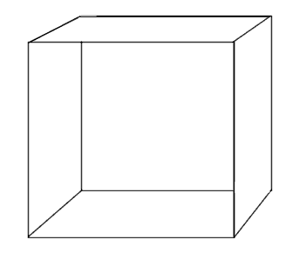
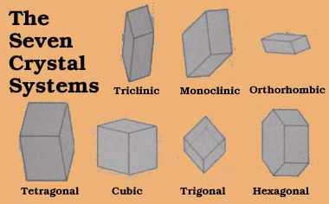
There are 7 crystal systems
a = b = c ; α = β = ϒ = 90
Cubic
All sides equal: all right angles
a = b ≠ c ; α = β = ϒ = 90
Tetragonal
Two sides equal: all right angles
a ≠ b ≠ c ; α = β = ϒ = 90
Orthorhombic
No sides equal: all right angles
a ≠ b ≠ c ; α ϒ = 90:β≠ 90
Monoclinic
No sides equal: Two right angles
a ≠ b ≠ c ; α,β ,ϒ≠ 90
Triclinic
No sides equal: No right angles
a = b ≠ c ; α=β=90 ,ϒ=120
Hexagonal
Two sides equal:Two right angles, One 120
a ≠ b ≠ c ; α,β ,ϒ≠ 90
Rhombohedral
All sides equal: Two right angles
c
α
b
β
ϒ
a

Slide 20
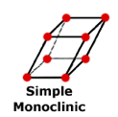
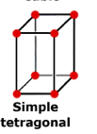
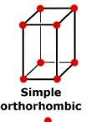
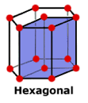
Within this 7crystal symmetries: there are 7 Primitive Lattices : Which gives the 7 Bravais Lattices in nature
a ≠ b ≠ c
α ϒ = 90:β≠ 90
a = b = c
α = β = ϒ = 90
a ≠ b ≠ c
α = β = ϒ = 90
a = b ≠ c
α = β = ϒ = 90
a ≠ b ≠ c
α,β ,ϒ≠ 90
a = b ≠ c
α=β=90 ,ϒ=120
a ≠ b ≠ c
α,β ,ϒ≠ 90
For the 7 primitive lattices, these unit cells are primitive

Slide 21
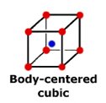
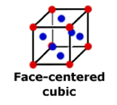
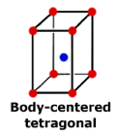
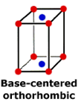
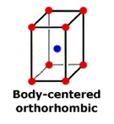
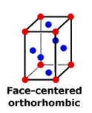
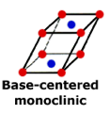
14 Bravais Lattices

Slide 22
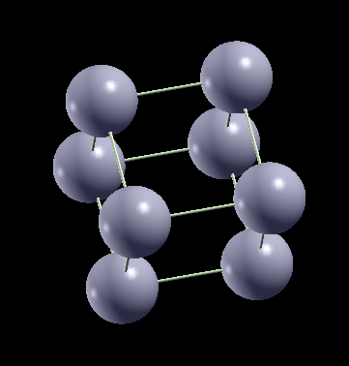
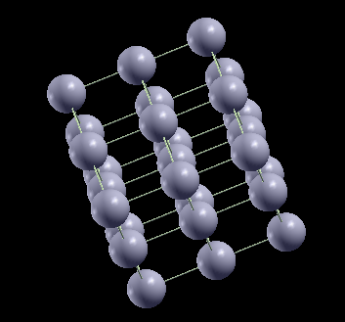
Examples: Simple Cubic
Not many Lattices come in this symmetry in Nature: One Example is Polonium.
Unit Cell has only one unit
Six Nearest Neighbors
Look at the XCRYSDEN FILES

Slide 23
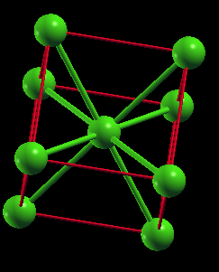
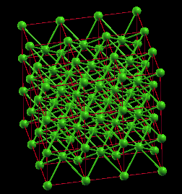
Examples: Body Centered Cubic – Li a=3.49 A
8 Nearest Neighbors
Conventional Cell
Repeating Conventional Cells
Look at the XCRYSDEN FILES

Slide 24
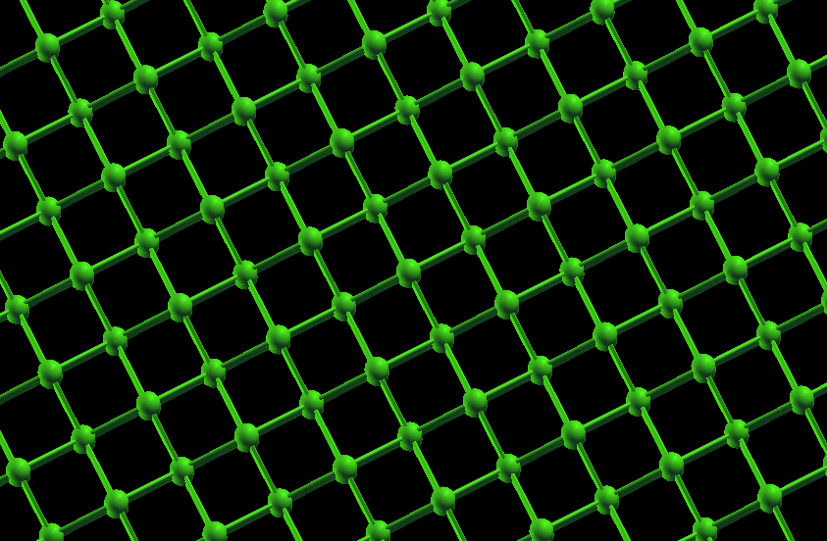
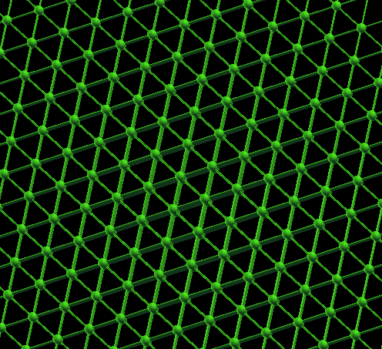
Different Planes in a BCC lattice

Slide 25
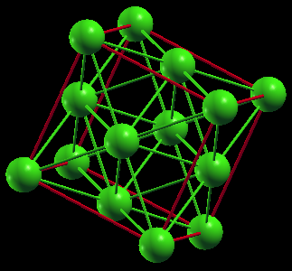
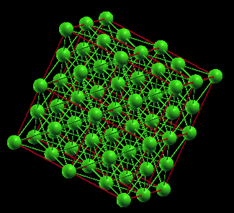
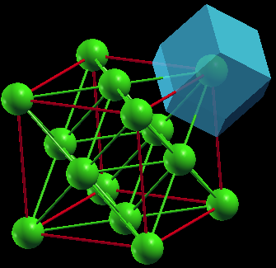
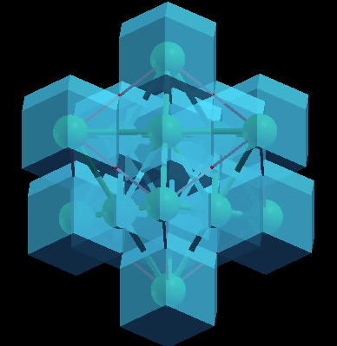
Examples: Face Centered Cubic - Cu
a=3.61
Conventional Cell
Repeating Conventional Cells
Wigner-Seitz Cell
Repeating Wigner-Seitz Cells

Slide 26
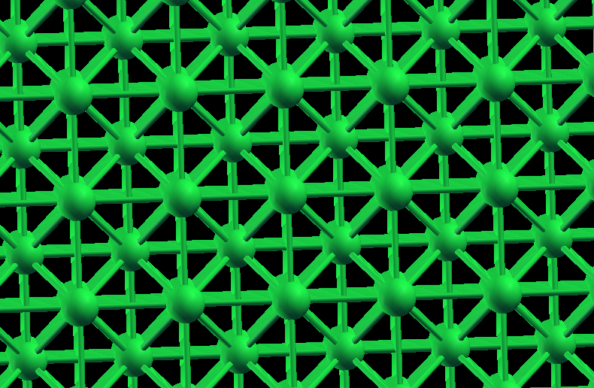
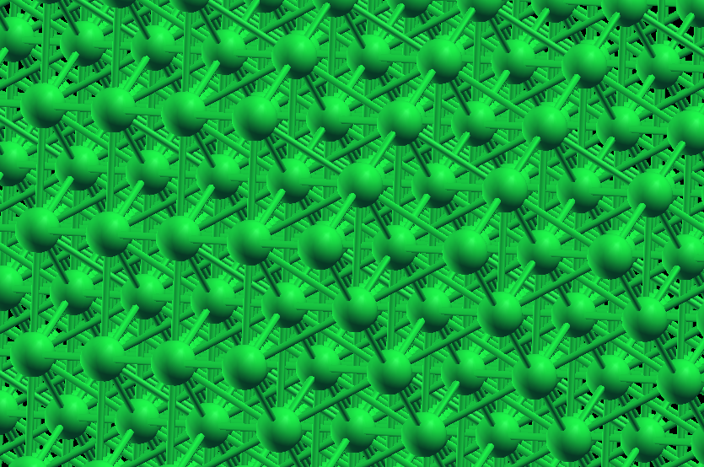
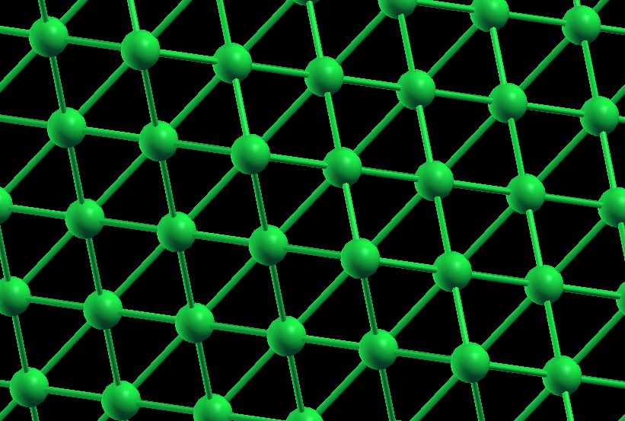
Different Crystal Planes of FCC

Slide 27
Lattice with Basis

Slide 28
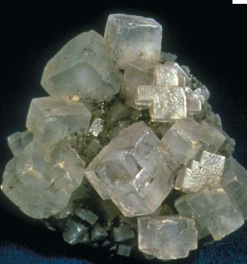
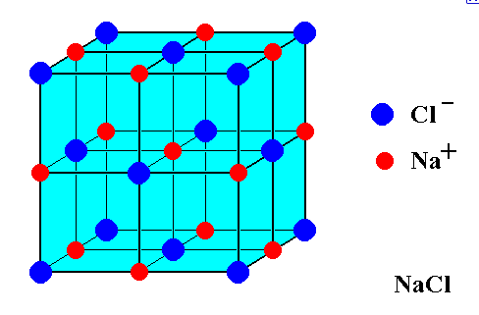
Rock Salt – Sodium Chloride
Examples for the structures with Sodium Chloride Structure
AgBr, LiI, NaI, BaS, AgF, AgCl

Slide 29
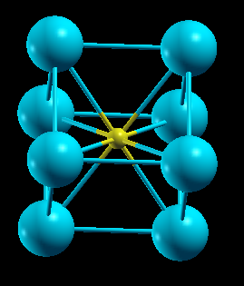
Cesium Chloride

Slide 30
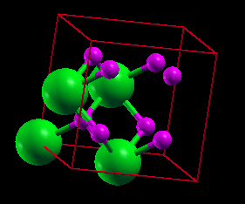
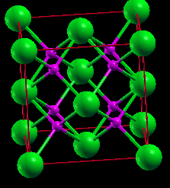
Fluorites – Cesium Fluoride Structure

Slide 31
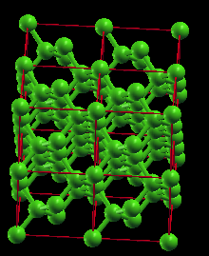
Diamond Structure – Single Atomic Structure

