Slide 1

PHYS 425 Spring 2013
Lecture 3
Instructor : Thushari Jayasekera
Southern Illinois State University - Physics

Slide 2
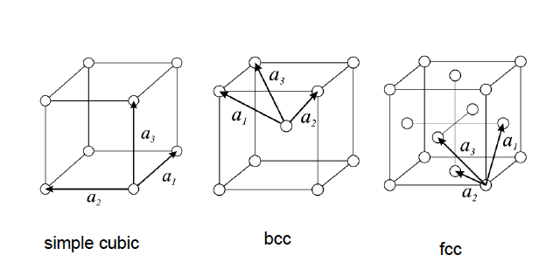
Conventional and Primitive Cells for the Cubic Lattices
a1, a2, a3 shows the primitive lattice vectors

Slide 3
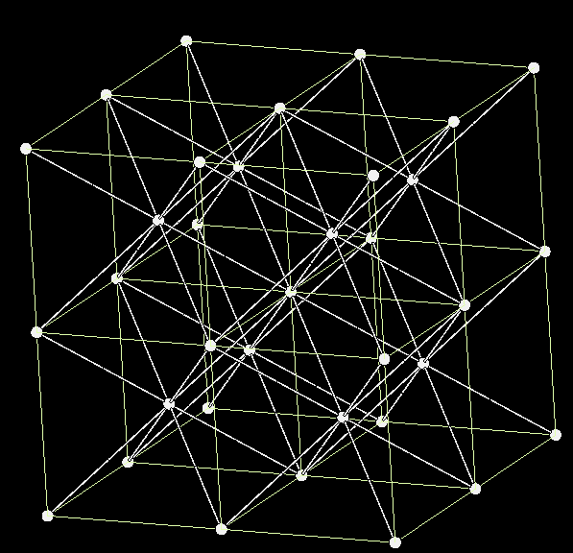
BCC Conventional Cell
Red arrow shows the primitive unit vectors. Primitive Cell is shown in the next page

Slide 4
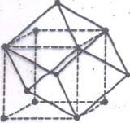
BCC Conventional Cell and Primitive Unit Cell

Slide 5
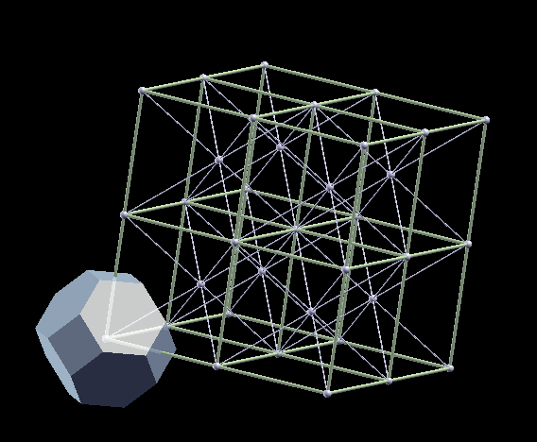
BCC Conventional Cell and Primitive Unit Cell & the Wigner-Seitz Unit Cell

Slide 6
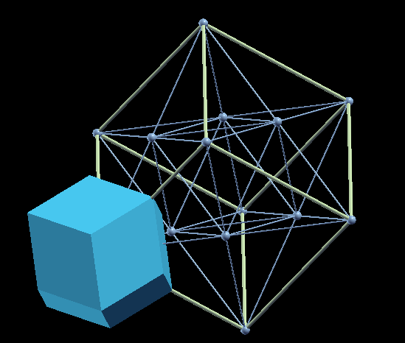
FCC Conventional Cell
It is easier to identify the Primitive unit cell here. Obviously there are more than one way. Unique/Symmetric Wigner-Seitz cell is also shown.

Slide 7
Examples for Crystal Lattices:
We discussed about some Bravais Lattices, It is I assume pretty clear (Li, Cu, Po)
We also talked about Lattices with Basis:
NaCl, CsCl, Diamond, ZincBlende

Slide 8
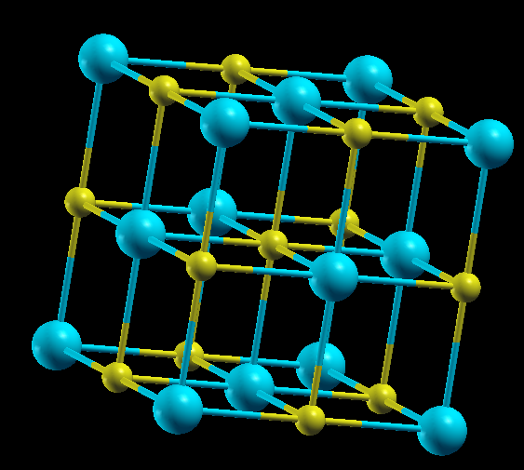
NaCl Structure

Slide 9
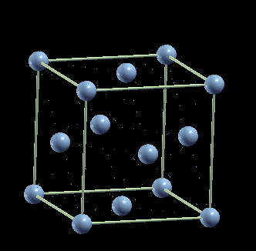
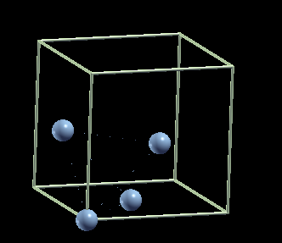

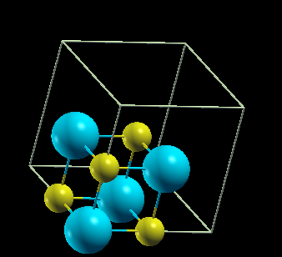
Let’s start with the FCC Bravais Lattice
Basis Atoms:
(000),
(1/2,1/2,0)
(0,1/2,1/2)
(1/2,0,1/2)
Now let’s substitute Each lattice point with a basis
Basic Idea is When we Define a non-Bravais Lattice, we need to define exactly where the atoms locate.
In NaCl structure:
Cl ions are at (000)(1/2,1/2,0),(0,1/2,1/2),(1/2,1/2,0) and Na ions at (1/2,0,0),((0,1/2,0),(0,0,1/2) and (1/2.1/2,1/2)
With this information, you also need to define the unit cell length, That is basically related to the bondlength.
+
=
We can also represent the same thing as:

Slide 10
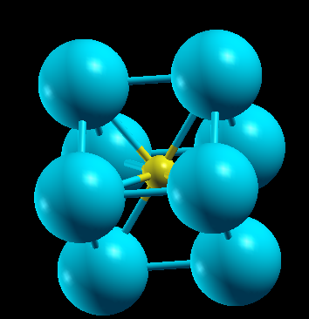
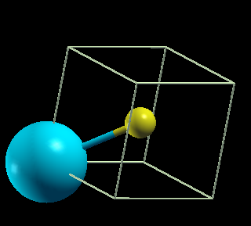
CsCl Structure
In CsCl structure:
Cs ions are at (000)
I ions at (1/2.1/2,1/2)
With this information, you also need to define the unit cell length, That is basically related to the bond length.

Slide 11
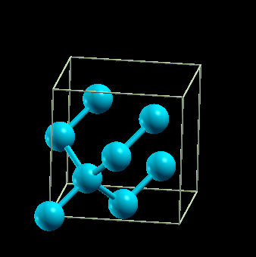
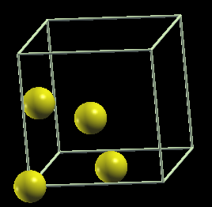
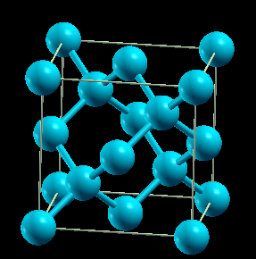
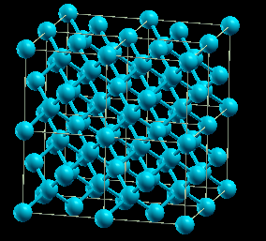
Diamond Structure
With Basis
The basis come with two identical atoms:
one at (000) and the other at (1/4,1/4,1/4)
Si, Ge, C come in the Diamond structure.
The have different unit cell length.
(In another words, of course they have different Bond-lengths.)

Slide 12
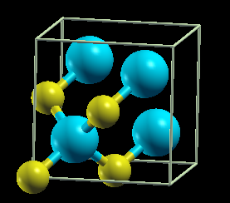
ZincBlende Structure
With Basis
The basis come with two different atoms:
one at (000) and the other at (1/4,1/4,1/4)
ZnS and other materials come in this structure

Slide 13
Other interesting and popular structures are :
Wurtzite – Hexagonal Structure with a Basis
Perovskite – Simple Cubic with a Basis
Hexagonal Close Packed – Hexagonal with a Basis (We will discuss that later)

Slide 14
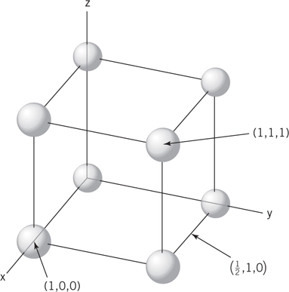
Crystallography – defining directions
Using a right-handed coordinate system, determine the coordinates of 2 points that lie in the direction of interest
Subtract the coordinates of the tail point from those of the head point
Clear fractions and reduce to the nearest integer
Enclose the result in brackets with a line above negatives

Slide 15
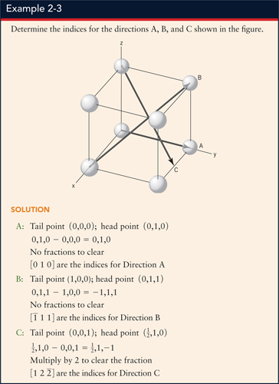

Slide 16
Example

Slide 17
Other points about directions
The directions are unit vectors so opposite signs are unequal. The are opposite directions along the same line (called anti-parallel).
Directions have no magnitude, so a direction and its multiple are equal provided that the signs do not change
(e.g., [1 2 3] = [2 4 6] = [3 6 9])

Slide 18
Crystallography – Miller Indices of planes
Identify where the plane intercepts the x-, y-, and z-coordinate lines in terms of number of lattice parameters
Take the reciprocals of the three points
Clear fractions, but do not reduce the results
Enclose the results in parenthesis

Slide 19
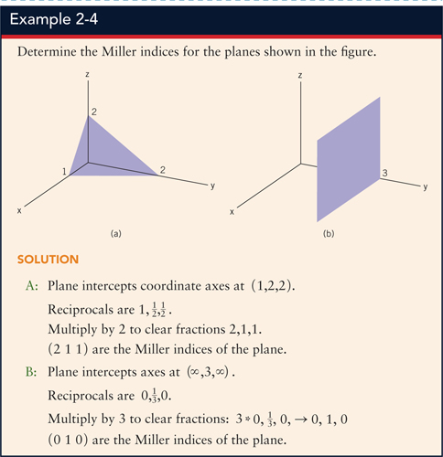

Slide 21
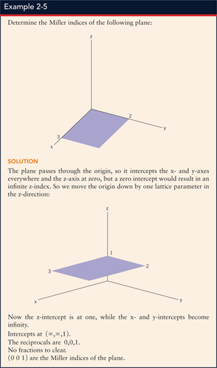

Slide 23
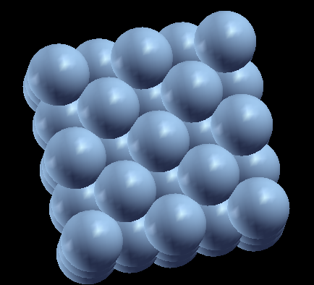
While we draw lattices as if they had lots of empty space, the atoms are packed tightly together.

Slide 24
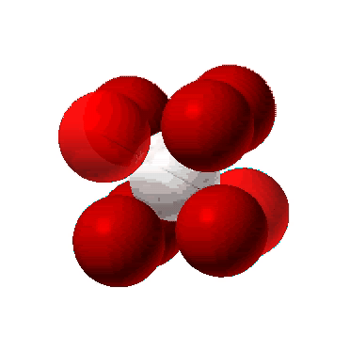
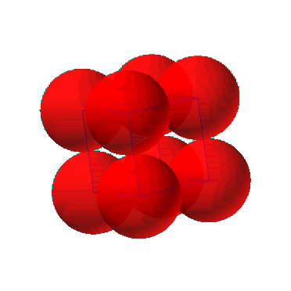
While we draw lattices as if they had lots of empty space, the atoms are packed tightly together.

Slide 25
Let’s go back to packing ….

Slide 26
There are several ways of packing atoms in space, Packing fraction can be calculated as we explained earlier.
Packing fraction of atoms in different systems:
SC ……. 0.52
BCC …… 0.68
FCC …. 0.74
Face centered cubic lattice has the highest packing fraction. Another is the hexagonal close-packed structure. They both have packing fraction equals 0.74
No other structure has denser packing.
Let’s look at (111) plane of the FCC:

Slide 27
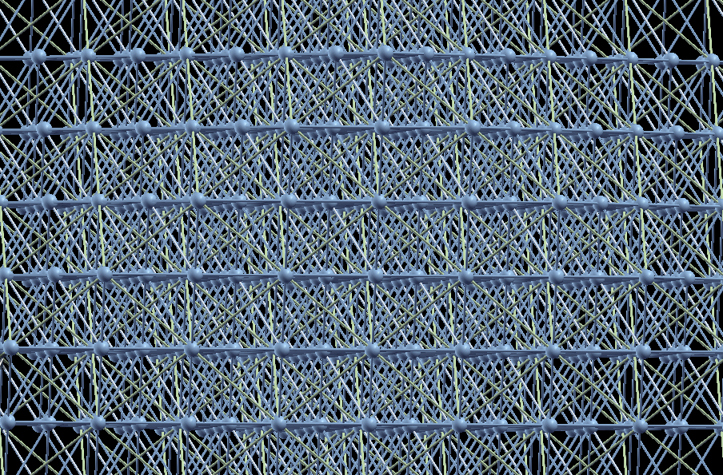
Cubic close packing

Slide 28
ABC – ABC Cubic Close Packed

Slide 29
Hexagonal Lattice with a Basis: Hexagonal Close Packed Structure: ABAB stacking

Slide 30
