Slide 1
PHYS 425 Spring 2013
Lecture 4
Electron Diffraction for Determination of Crystal Structures
Instructor : Thushari Jayasekera
Southern Illinois State University - Physics

Slide 2
Let’s review what we have been doing so far:
- Bravais Lattices
- Examples for common Crystal Structures and identified their Bravais Lattice types
- Miller indices for different planes
- Packing Fraction and closely packed structures.

Slide 3
HCP (ABABAB..) and CCP (ABCABCABC….) both have the highest packing fraction of 0.74
A
A
A
A
A
A
A
A
A
A
A
A
A
A
C
C
C
C
C
C
B
C
B
C
B
C
B
C
B
C
B
C
B
A
B
A
B
A
B
A
B
A
B
A
B
A
B
A
A
A
A
A
A
A
C
C
C
C
C
C
C
B
C
B
C
B
C
B
C
B
C
B
B
A
B
A
B
B
B
B
B
B
A
A
A
A
A
A
A
A
A
A
A
A
C
C
C
C
C
B
C
B
C
C
C
C
C
B
B
C
B
B
B
B
B
A
A
A
B
A
B
A
B
A
B
A
B
A
A
A
A
A
A
A
C
C
C
C
C
C
C
B
C
B
C
B
C
B
C
B
C
B
B
A
B
A
B
A
B
A
B
A
B
A
B
A
B
A
A
A
A
A
A
A
A
A
A
A
A
A
A
A
A
A
A
A
A
A
C
C
C
C
C
C
B
C
B
C
B
C
B
C
B
C
B
C
B
A
B
A
B
A
B
A
B
A
B
A
B
A
B
A
A
A
A
A
A
A
C
C
C
C
C
C
C
B
C
B
C
B
C
B
C
B
C
B
B
A
B
A
B
B
B
B
B
B
A
A
A
A
A
A
A
A
A
A
A
A
C
C
C
C
B
B
C
C
C
C
B
B
C
C
C
C
B
B
B
B
B
A
A
A
B
A
B
A
B
A
B
A
B
A
A
A
A
A
A
A
C
C
C
C
C
C
C
B
C
B
C
B
C
B
C
B
C
B
B
A
B
A
B
A
B
A
B
A
B
A
B
A
B
A
A
A
A
A
A
A
A
A
A
A
A
A
A
A
A
A
A
A
A
A
B
C
B
C
B
C
B
C
B
C
B
C
B
C
C
C
C
C
C
A
A
A
A
A
A
A
A
B
A
B
A
B
A
B
A
B
A
B
A
B
C
B
C
B
C
B
C
B
C
B
C
B
B
C
C
C
C
C
C
A
A
A
A
A
A
A
A
B
A
B
B
B
B
B
B
C
C
A
A
A
A
A
B
B
C
C
C
C
C
C
B
B
B
B
B
B
B
C
C
C
C
A
A
A
A
A
A
A
A
A
A
B
A
B
A
B
A
B
A
B
C
B
C
B
C
B
C
B
C
B
C
B
B
C
C
C
C
C
C
A
A
A
A
A
A
A
A
B
A
B
A
B
A
B
A
B
A
B
A
B

Slide 4
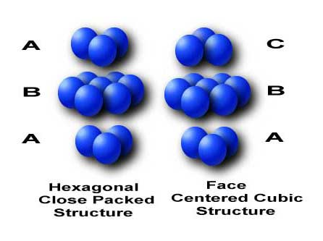
HCP (ABABAB..) and CCP (ABCABCABC….) both have the highest packing fraction of 0.74

Slide 5
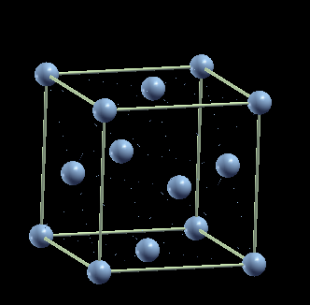
Planar and Linear Densities:
Previously we have calculated the packing fraction in terms of the space taken by the volumes compared to the empty volume in the crystal
Similarly we can calculate the Linear Density and the planar density.
Atomic Packing Fraction = Volume of atoms in a Unit Cell / Total Unit cell volume
Linear Density = Number of Atoms centered on a direction vector /Length of the direction vector
Planar Density = Number of Atoms centered on a Plane / Area of the Plane
(110) plane
[110]direction

Slide 6
Crystallographicaly equivalent directions
That said, we can find that for some crystal structures, several non-parallel directions with different indices are crystallographicaly equivalent. This means that the atomic density, i.e. atomic arrangements are same along these directions.
For example in cubic crystals [100] [-1 00],[010],[0-10],[001][00-1] directions are equivalent to each other.
(Pl. note I have used – signs which is not the proper way of writing Miller Indices)
In that case we call it <100> family
In Hexagonal crystals however, the directions with equivalent crystallographic properties do not have the same Miller indices. This problem is solved by introducing four-axes indices.
=> Then the indices are called Bravais-Miller Indices
This four axis system notation is kind of redundant, But convenient

Slide 7
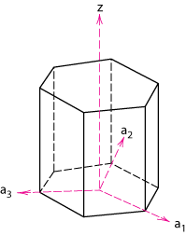
Crystallographic Planes (HCP)
z
In hexagonal unit cells the same idea is used
example
a₁ a₂ a₃ c
1. Intercepts
1 ∞
-1
1
2. Reciprocals
1 1/∞
-1
1
1 0
-1
1
a₂
3. Reduction
1 0
-1
1
a₃
4. Miller-Bravais Indices
(1011)
a₁
Adapted from Fig. 3.8(b), Callister & Rethwisch 8e.

Slide 8
Identifying Crystal Structures

Slide 9
X-ray diffraction
X-ray source shoots a beam into a sample while a detector collects the diffracted radiation
Source and detector rotate until a broad range of angles of incidence are measured

Slide 10
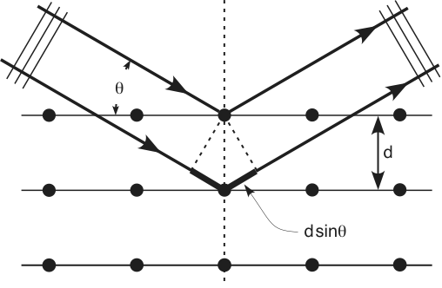
Conditions for a Sharp Peak in the Diffracted Beam
Bragg diffraction pattern: A signature of the crystal structure.

Slide 11
X-Rays to Determine Crystal Structure
• Incoming X-rays diffract from crystal planes.
“1”
detector
Measurement of critical angle, θ_{c}, allows computation of planar spacing, d.
incoming
reflections must
X-rays
“2”
be in phase for
“1”
outgoing X-rays
a detectable signal
extra
“2”
λ
distance
θ
θ
Adapted from Fig. 3.20, Callister & Rethwisch 8e.
travelled
by wave “2”
spacing
d
between
planes
X-ray
intensity
n λ
d =
(from
2 sin
θ
c
Only certain values of theta will satisfy the Bragg Law.
detector)
θ
θ
c
We can identify different diffraction peaks related to the existence of different planes.

Slide 12
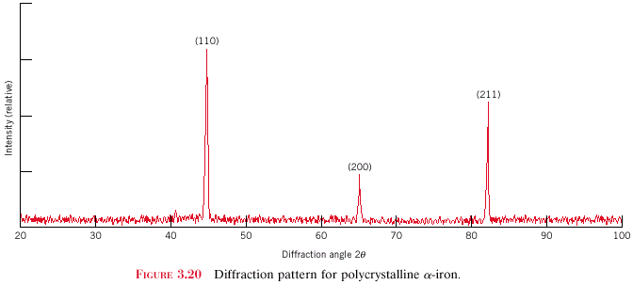
X-Ray Diffraction Pattern
z
z
z
c
c
c
y
(110)
y
y
a
b
a
b
a
b
x
x
x
(211)
Intensity (relative)
(200)
Diffraction angle 2θ
Diffraction pattern for polycrystalline α-iron (BCC)
Adapted from Fig. 3.22, Callister 8e.

Slide 13
Satisfying Bragg’s Law is a necessary Condition, but not sufficient for a successful diffraction peak.

Slide 14
X-Ray Diffraction Conditions in a different prospective
The scattering intensity depends on the local distribution of electrons. Let’s focus on the local electron contribution.
The crystal structure has a long-range periodicity. So does the electro density.

Slide 15
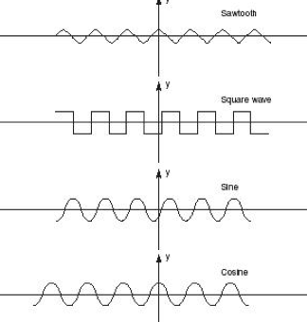
Electron Density is a Periodic function
Bragg Diffraction Pattern is determined by the electron density n(r) in the system.
What are the periodic functions?

Slide 16
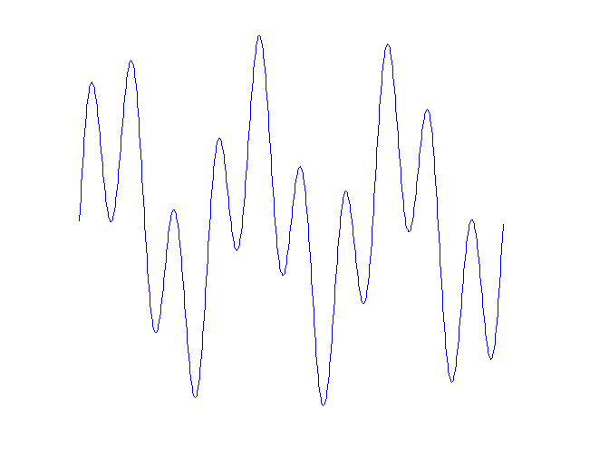
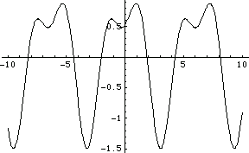
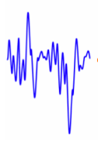
More about periodic functions?
What is the best way to learn about periodic functions?

Slide 17
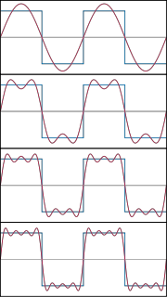
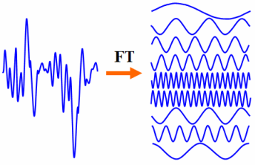
What is the best way to learn about periodic functions?
Fourier Transform:
Now let’s get back to the Bragg Diffraction Condition.

Slide 18
The electron density can be written as:
Look at the notes (and the textbook) for explanation.
In order to define the periodic nature of electron density, we define a new vector G
This set of new vector G define another long range system of points. The periodic array defined by this vector G is called the Reciprocal Lattice.

Slide 19
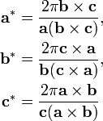
What are these set of special wave vectors?
This set of new vectors create another periodic structure. Definitely, this periodic structure is a one to one match to the periodic lattice of the Crystal Lattice Structure
Crystal Lattice
Reciprocal Lattice

